Slide 1
POWER BI

Slide 2
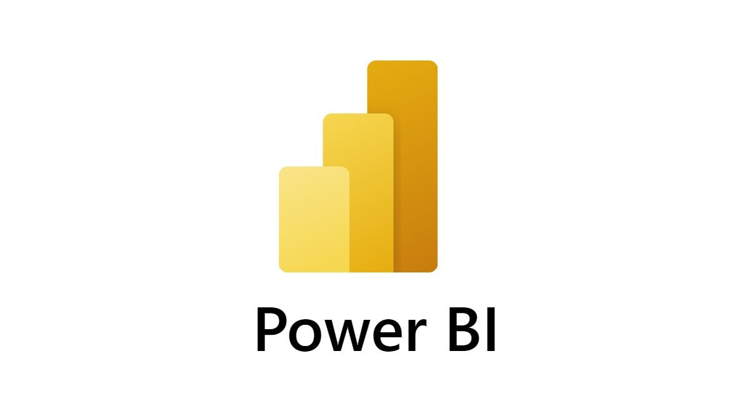

Slide 3
What is power BI ?
Power BI is defined as Power Business Intelligence.
It helps you analyze, visualize, and share data in the form of interactive dashboards.
It is a data visualization tool developed by Microsoft.

Slide 4
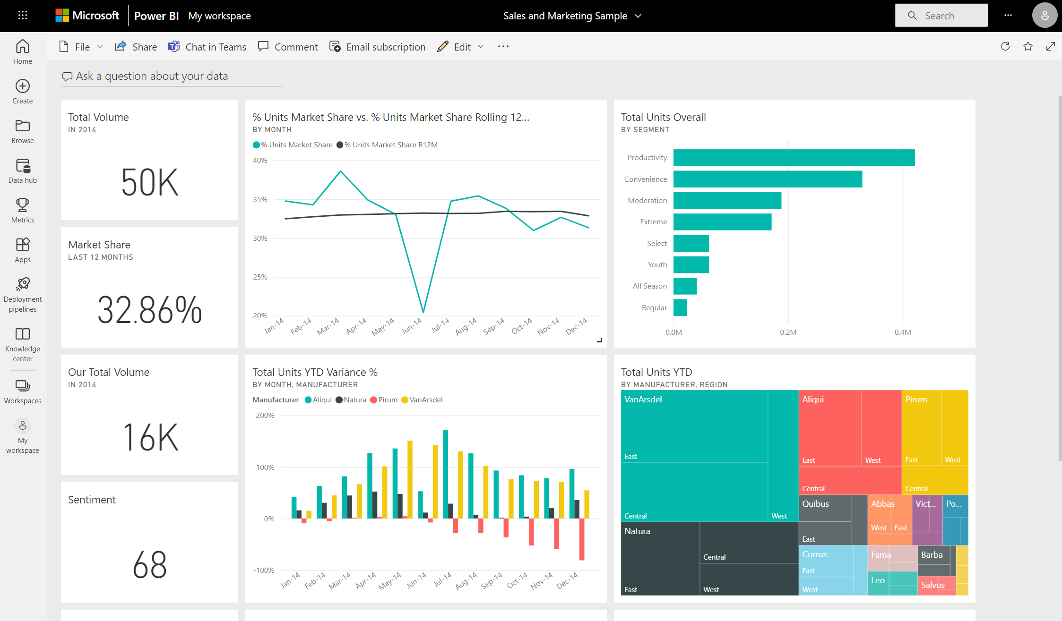
Features of Power BI
Import data from different sources (Excel, SQL, APIs, CSV, cloud services).
Clean and transform data.
Create charts, graphs, and dashboards.
Share insights with your team or clients.

Slide 5
Components of Power BI
Power BI Desktop
Used for data modeling, cleaning, transforming, and creating reports.
Power BI Service (Cloud)
Used to publish, share, and collaborate on dashboards online.
Power BI Mobile Apps
Apps for Android & iOS to view dashboards on mobile devices.

Slide 6
Power BI Gateway
Connects on-premise data (local databases, servers) to Power BI Service.
Power BI Report Server
Used to host and share reports on-premise (within the company network).
Power BI Embedded
For developers who want to embed Power BI visuals in applications.

Slide 7
Amazon Sales Dashboard

Slide 8
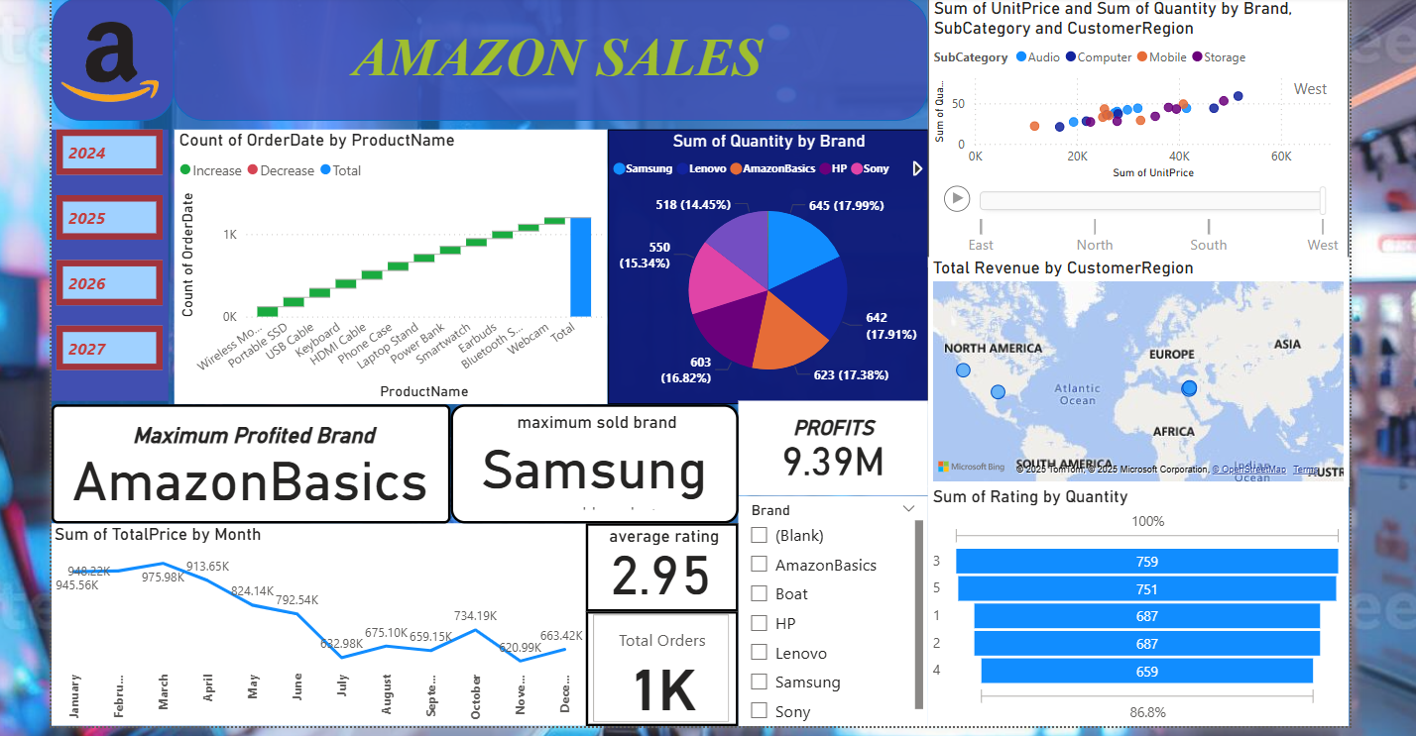

Slide 9
Where is Power BI Used ?
Business analysis
Sales reports
Marketing dashboards
Finance & accounting
HR analytics
Operational performance tracking

Slide 10
THANK YOU

